Slide 1
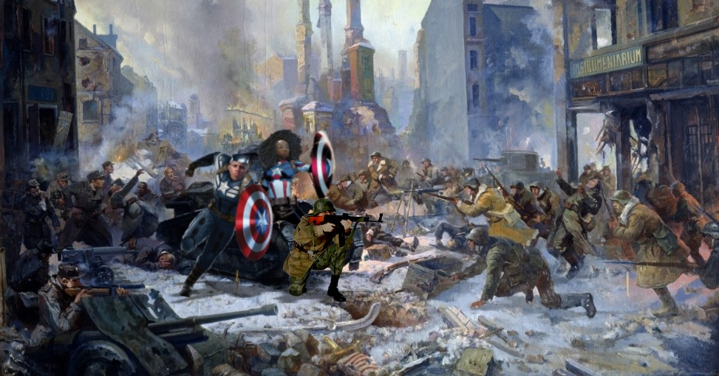

Captain Mateus and Major Isabelle

